Slide 1
Unimproved Roads
City Commission Workshop
Engineering Department
Date: October 2, 2023

Slide 2
Unimproved Roads
Introduction:
Current Special Assement District (SAD) Policy
Selecting Water and Sewer Projects
Scoring Process
Priority Roads List
Selecting Projects
Unimproved to Improved Road Information
Street Standard
Lakeview Avenue
Cost of Cape Seal and Improved Roads

Slide 3
Current Special Assement District (SAD) Policy
Sec 94 – Special Assement
Revised in October 2021
Initiation of Improvement by Commission
Property owners may petition for an improvement

Slide 4
SAD Unimproved Roads
Cape Seal
85% of the front-foot costs for improvement are assessed on all properties fronting on the improvement.
25% of the side-foot costs for improvement are assessed on all residential properties siding on the improvement.
85% of the side-foot costs for improvement are assessed on improved business properties siding on the improvement.
25% of the side-foot costs for improvement are assessed on vacant business properties siding on the improvement.

Slide 5
SAD Unimproved Roads
Unimproved to Improved Road
85% of the front-foot costs for improvement are assessed on all properties fronting on the improvement.
For single family houses, if the longer side of a corner property faces the street being constructed, the City will pay two-thirds (2/3) of the cost of the assessment for that property. The property owner will be charged the remaining third (1/3). If the short side of a corner property faces the street to be constructed, the owner pays 100% of the assessment.

Slide 6
Selecting Water and Sewer Projects
Scoring Process
Road: 0-100 points
Sewer: 0-100 points
Water: 0-100 points
Higher points: Required Replacement
Max Point: 300 points

Slide 7
Road Scoring Process (up to 100 Points)
PASER Rating
In PASER:
10: Great Condition of Pavement
1: Poor Condition of Pavement
Road Scoring Process (up to 100 Points):
(10-2021 PASER Rating) x 10
Example: PASER Rating 7
(10 - 7) X 10 = 30
Example: PASER Rating 2
(10 - 2) X 10 = 80

Slide 8
Water Scoring Process (up to 100 Points)
Age (0-20)
1 year old: 0 points
75 years old (expected service life): 20 points
Size (0-20)
Current minimum size 8”
6” water main: 10 points
4” water main: 20 points
Reinforcement (0-20)
Water Pressures from water modeling:
Points are assigned based on double the change in size recommended in the model
Example: existing 6” water main, model calculates 12” water main: (6 x 2) = 12 points
Frequency of Breaks (0-40)
Each water main break equals 4 points
City records go back to approximately 1960’s

Slide 9
Sewer Scoring Process (up to 100 Points)
Structural Condition (0-30)
Segments with pipe fractures, cracks, and voids are scored higher
Operation and Maintenance (0-20)
Segments that require frequent cleanings due to slow flows, roots, etc. are scored higher
Capacity Deficiency (0-40)
Segments that are calculated as being too small for their service area
Relief Sewer (0-10)
Points are given to segments that help drain not only immediate area but upstream areas.

Slide 10
Unimproved Road Scoring List

Slide 11
Selecting Projects
Input from City Departments:
Fire Department
Department of Public Service
Utility Phasing
Street Phasing

Slide 12
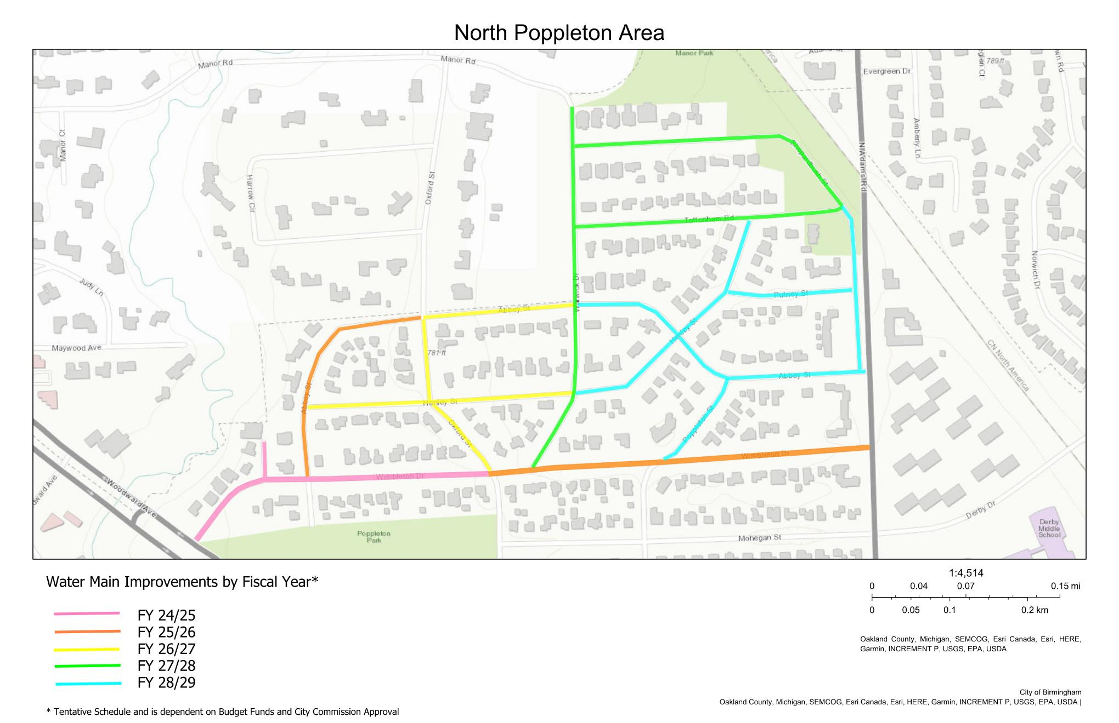
Selecting Project Example

Slide 13
Unimproved to Improved Road
Unimproved Road: Existing Width Varies

Slide 14
Unimproved to Improved Road: Street Standard Width
Improved Road: 26’ wide standard width for Residential Street Width Policy
Note: Existing City streets that are measured less than 20 feet wide the City offers a 20 feet wide pavement with no parking on one side.

Slide 15
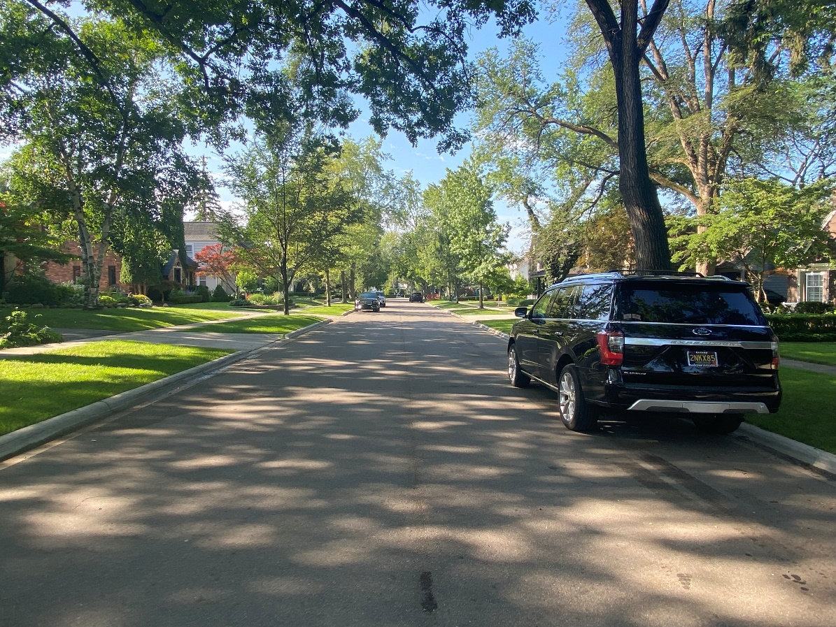
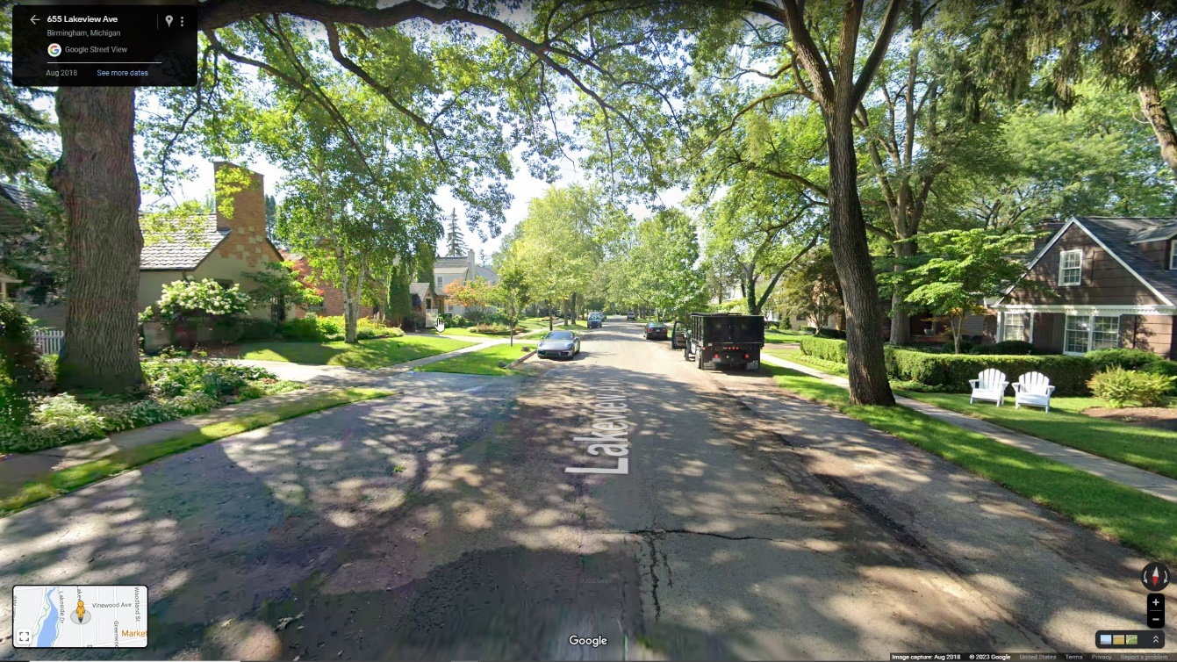
Lakeview Ave.
Before
After

Slide 16
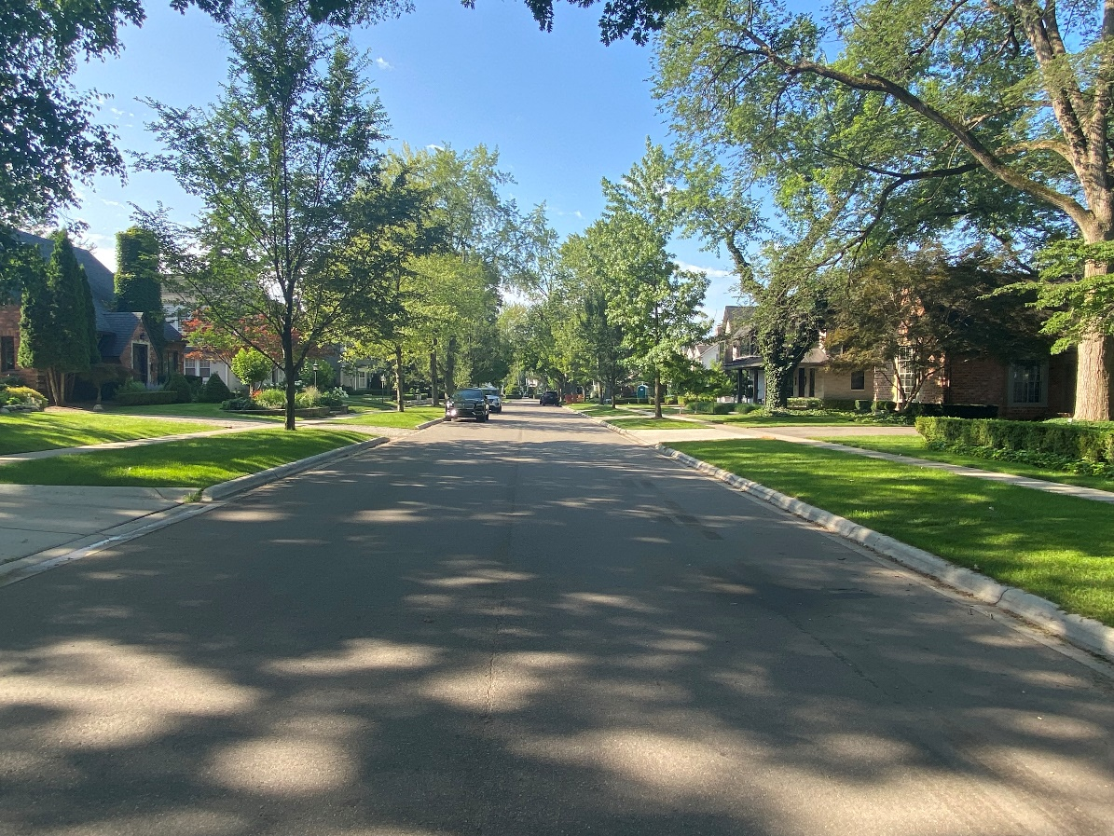
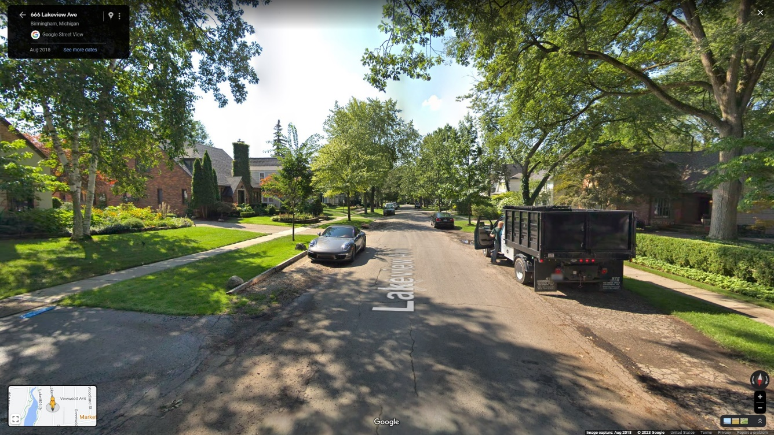
Lakeview Ave.
Before
After

Slide 17
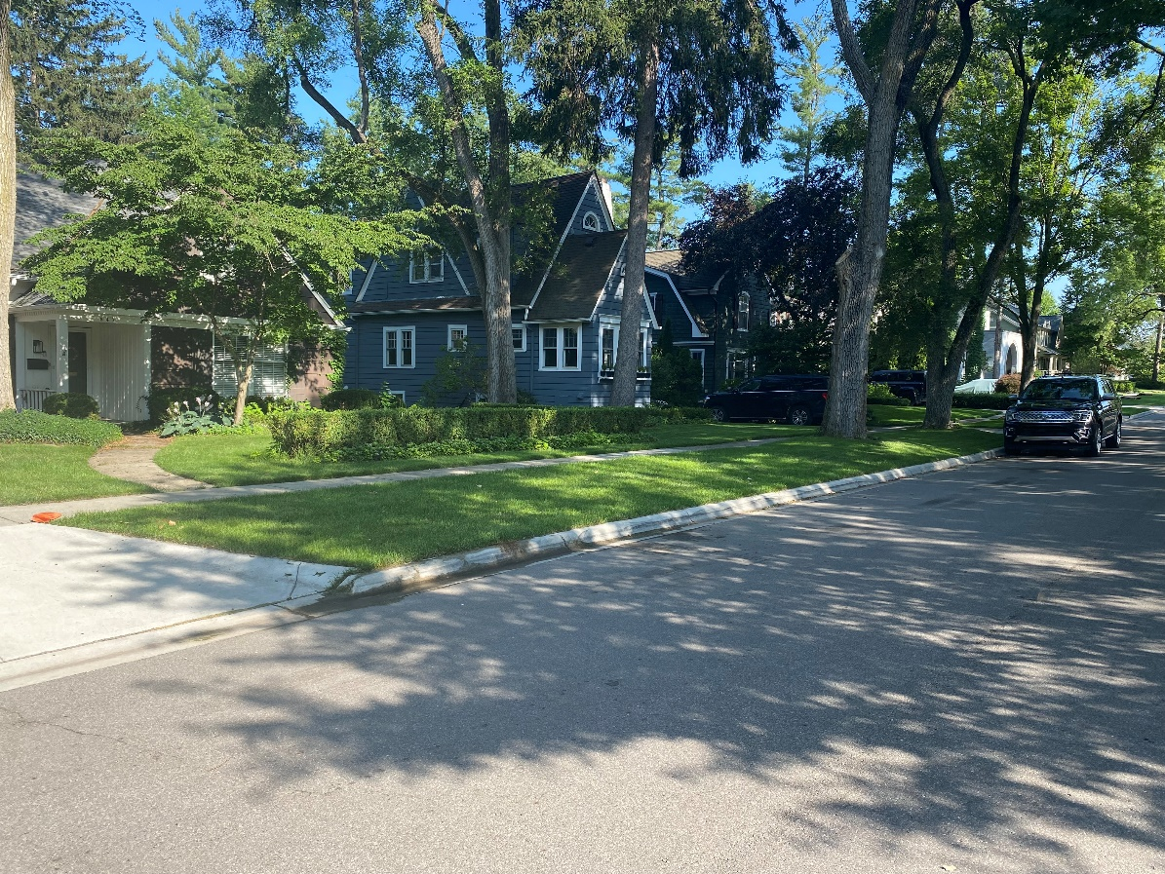
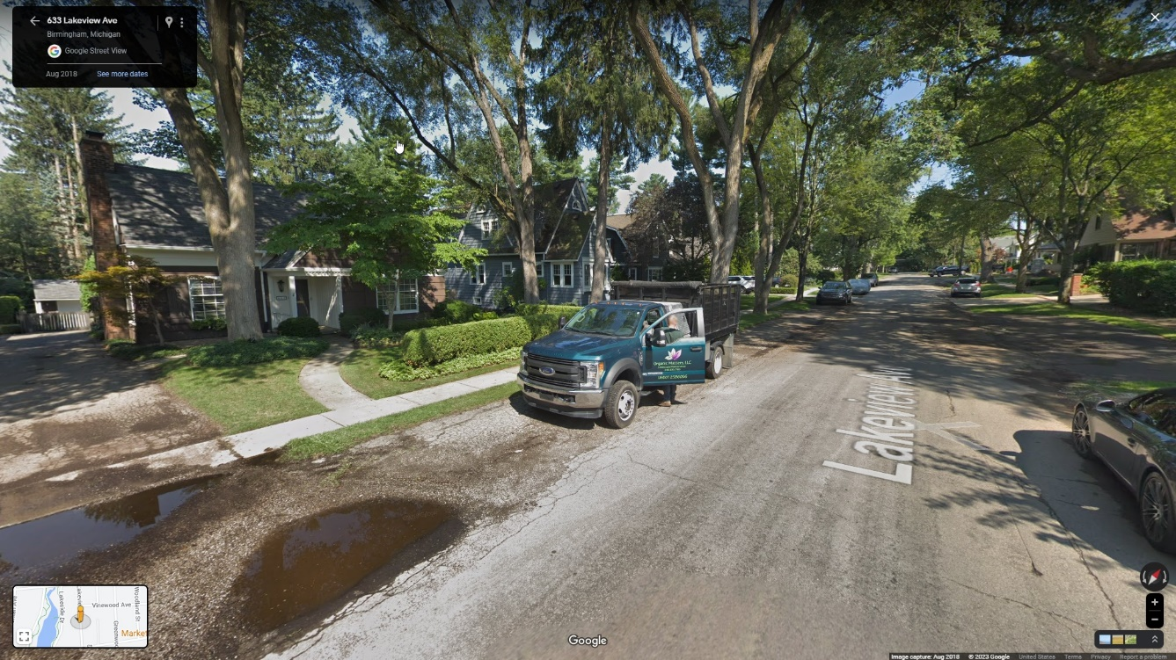
Lakeview Ave.
Before
After

Slide 18
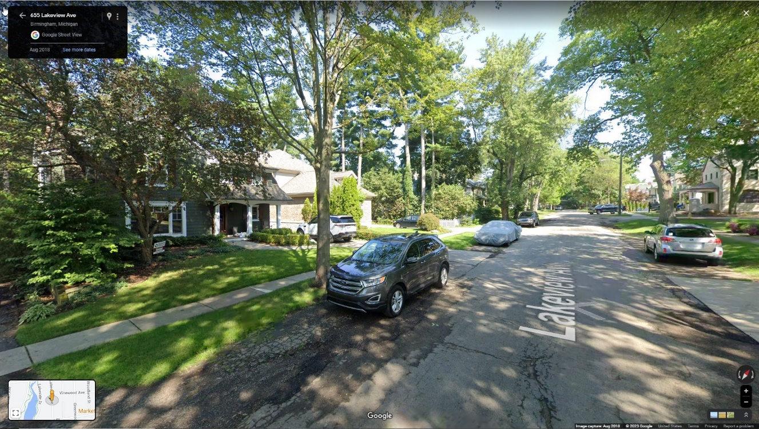
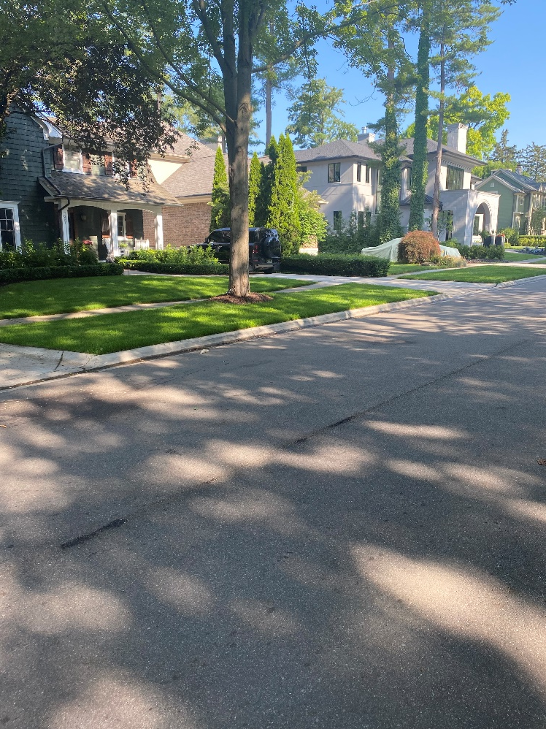
Lakeview Ave.
Before
After

Slide 19
Cost – Cape Seal
2022-2023 Cape Seal Program:
SAD Estimated Cost: $38.00/lft
SAD Projected Cost (from Bids and Construction): $27.00/lft +/-
50’ Lot:
Resident: $27.00*50’*85%= $1,147.50 (no payment option)
City: $27.00*50’*15%= $202.50
2032-2033 Future Cape Seal:
SAD Projected Cost (5% Inflation): $43.98/front +/-
50’ Lot:
Resident: $44.00*50’*85%= $1,870.00 (no payment option)
City: $44.00*50’*15%= $330.00
Resident Cost 10 year Period: $3,017.50

Slide 20
Cost – Improved Road
2022-2023 Improved Road:
Estimated Cost for Paving Assement: $350.00/lft
Estimate Cost for Drive Approach Assement: $11.75/sft
50’ Lot:
Resident: (($350.00*50’)+($11.75*130 sft))*85%= $16,173.38
City: (($350.00*50’)+($11.75*130 sft))*15%= $2,854.13
Resident Cost: $16,173.38 (10 year payment option)

Slide 21
Cost – Breakeven Point
 | Cape Seal | Improved Road
2023 | $1,147.50 | $16,173.38
2033 | $1,870.00
2043 | $3,045.00
2053 | $4,959.43
2063 | $8,078.39
 | $19,100.32 | $16,173.38

